Slide 1




Introduction to Software Development
Software Types and Bug Fixing Importance
QA
Fundamentals
Ivan Yonkov
Technical Trainer
http://github.com/RoYaLBG
Software University
http://softuni.bg

Slide 2

Table of Contents
What is Software?
Software Distribution Types
Retail software
Web applications
Mobile applications
Why Bugs Still Occur?
Bug Fixing Importance

Slide 3

Software Development

Slide 4
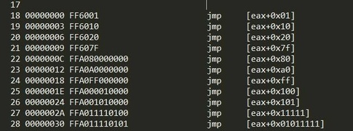
First Look at Software
Software definition
Software is any set of machine-readable instructions that directs a computer's processor to perform specific operations

Slide 5
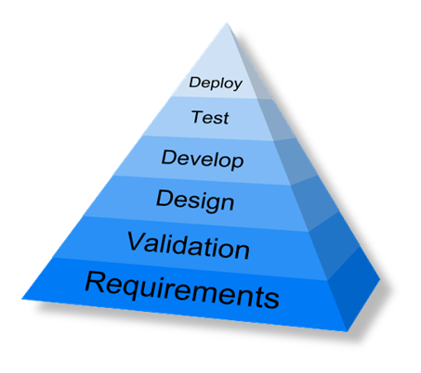
First Look at Software (2)
Developed for 8 decades
Evolved into a profession
Concerned into quality maximizing
Software engineering
Best practices for writing code
Management issues (team size, process, etc…)
On-time deliver
Work-place culture

Slide 6

Software Distribution

Slide 7
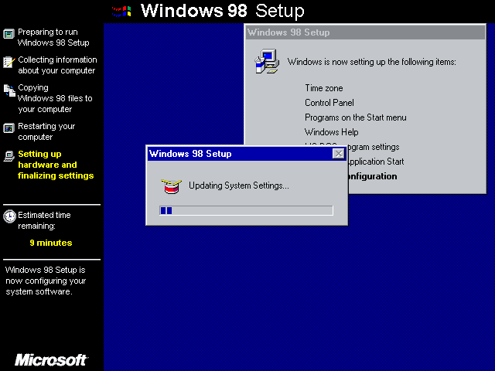
Retail Software

Slide 8

Retail Software
The vast majority of software until the emergence of internet

Slide 9
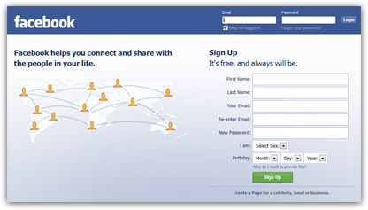
Web Applications

Slide 10


Web applications
The concept has been introduced in 1999 in Java Servlets
A major leap in the software distribution
Browsers and technologies are developed in favor of web apps
2005 – the term Ajax was coined
2011 – HTML5 was finalized

Slide 11
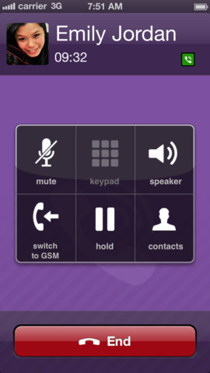
Mobile applications

Slide 12


Mobile Applications
App distribution platforms began appearing in 2008
Apple app store
Google play
Windows phone store
Started as productivity and information retrieval apps
Reached bigger market share than retail software

Slide 13

Bugs!

Slide 14

Why bugs still occur
People DO make mistakes
Software complexity
Requirements (quality, change…)
Deadlines
Obsolete automation scripts
Lack of skilled testers

Slide 15

Bug Fixing Importance

Slide 16

Bug fixing importance (2)

Slide 17

Bug Fixing Importance (3)
Unfixed bugs camouflage other bugs
Suggest quality isn’t important
Duplicate effort
Unreliable metrics and money loss
Fixing a bug today costs less than tomorrow

Slide 18

Summary
Software evolved through the time
Retail, web, mobile
It still has bugs
Reasons does not change
Importance of fixing bugs
More costumers
More money
No unsatisfied developers

Slide 19









Introduction to Software Development
http://softuni.org/courses

Slide 20
License
This course (slides, examples, demos, videos, homework, etc.) is licensed under the "Creative Commons Attribution-NonCommercial-ShareAlike 4.0 International" license
Attribution: this work may contain portions from
"Fundamentals of Computer Programming with C#" book by Svetlin Nakov & Co. under CC-BY-SA license
"C# Part I" course by Telerik Academy under CC-BY-NC-SA license

Slide 21





Free Trainings @ Software University
Software University Foundation – softuni.org
Software University – High-Quality Education, Profession and Job for Software Developers
softuni.bg
Software University @ Facebook
facebook.com/SoftwareUniversity
Software University @ YouTube
youtube.com/SoftwareUniversity
Software University Forums – forum.softuni.bg

